Slide 1
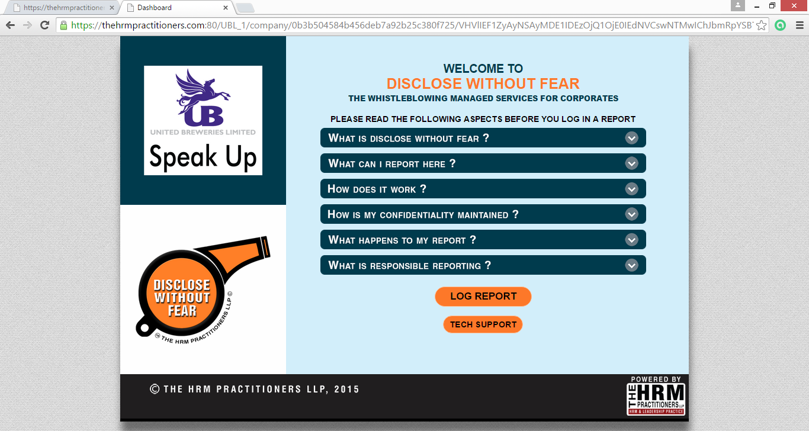
WELCOME TO
SPEAK UP@UBL
HOSTED BY
THE HRM PRACTIONERS, LLP

Slide 2
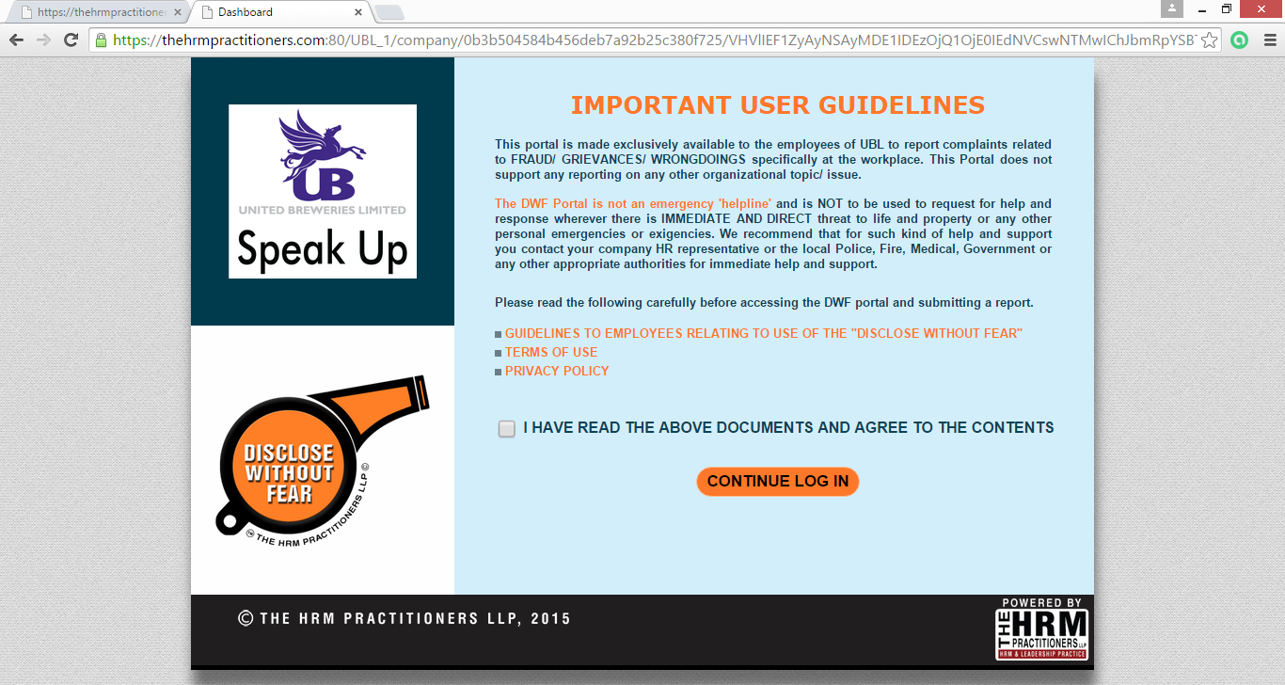

Slide 3
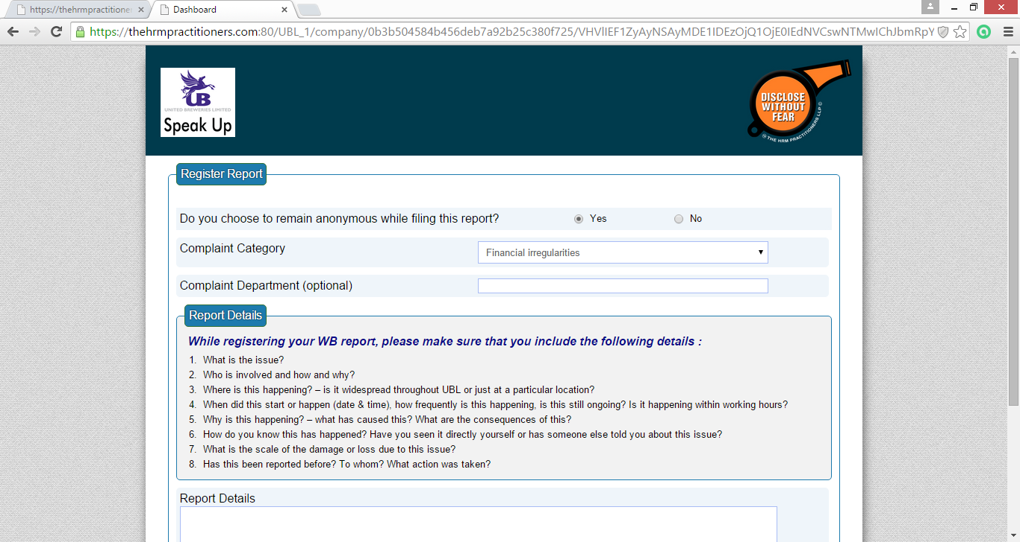
Replace this logo with the THRMP logo

Slide 4
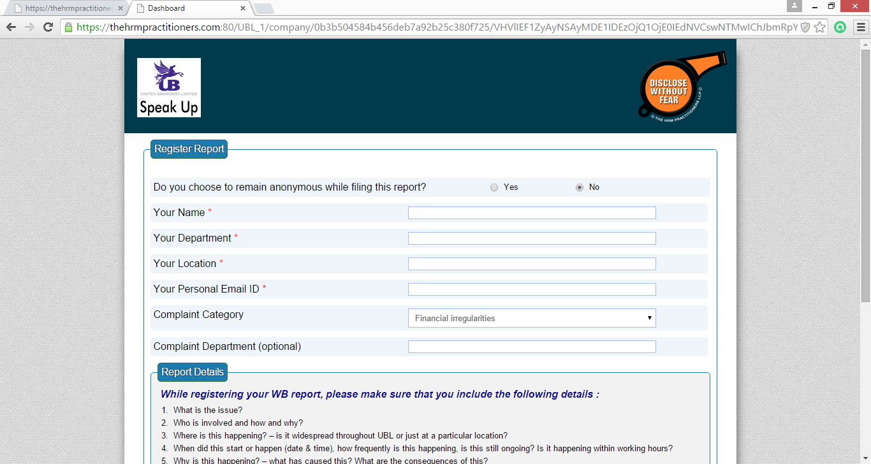

Slide 5
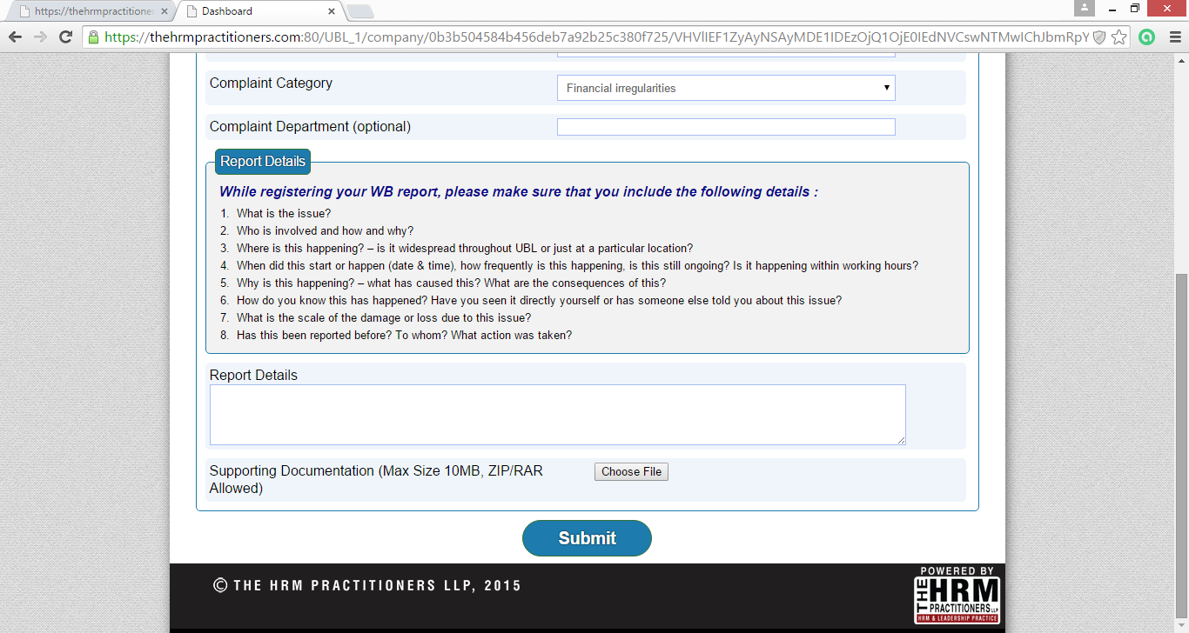

Slide 6
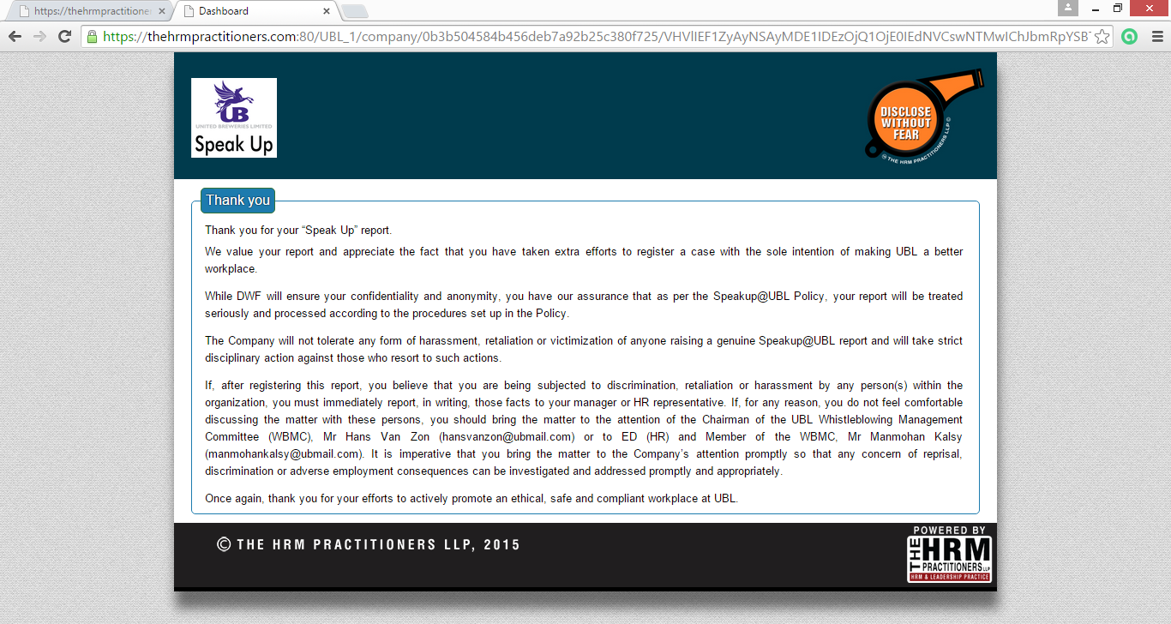
See below

Slide 7
“Thank you for your “Speak Up” report.
We value your report and appreciate the fact that you have taken extra efforts to register a case with the sole intention of making UBL a better workplace.
While we will ensure your confidentiality and anonymity, you have our assurance that as per the Speakup@UBL policy, your report will be treated seriously and processed according to the procedures set up in the policy.
The Company will not tolerate any form of harassment, retaliation or victimization of anyone raising a genuine Speakup@UBL report and will take strict disciplinary action against those who resort to such actions.
If, after registering this report, you believe that you are being subjected to discrimination, retaliation or harassment by any person(s) within the organization, you must immediately report, in writing, those facts to your manager or HR representative. If, for any reason, you do not feel comfortable discussing the matter with these persons, you should bring the matter to the attention of the Chairman of the UBL Whistleblowing Management Committee (WBMC), Mr Hans Van Zon (hansvanzon@ubmail.com) or to the EVP (HR) and Member of the WBMC, Mr Manmohan Kalsy (manmohankalsy@ubmail.com) or to VP (Legal) and Member of the WMBC, Mr Govind Iyengar. It is imperative that you bring the matter to the Company’s attention promptly so that any concern of reprisal, discrimination or adverse employment consequences can be investigated and addressed promptly and appropriately.
Once again, thank you for your efforts to actively promote an ethical, safe and compliant workplace at UBL.

Slide 8
DWF INCIDENT LOGGING PAGE
Hello,
You are about to log in a Whistleblowing case.
Before you do so, we want to bring to your notice the following points again –
Please make sure that you are logging in a genuine WB case and NOT misusing this portal to malign, victimize, retaliate or take revenge on any UBL employee. Any employee, who registers a WB report with mala fide intentions and which is subsequently found to be false will be subject to strict disciplinary action as per the UBL disciplinary framework.
Although UBL accepts anonymously reported WB cases, it encourages it’s employees to disclose their identity while registering the WB report and assures them of confidentiality and protection as per the SPEAKUP POLICY as this will help conduct the investigations more accurately and objectively.
Your personal details are safe with us. Even though you disclose your identity while registering your WB case, we will keep your identity confidential and only report the case details to UBL*. In case UBL requests for more data, they will send us their queries on your case and we will write to you with those queries and request you to provide further information/ clarifications.
I want to provide my personal details. I understand that the DWF portal will maintain my anonymity and confidentiality and not provide any of my personal details that I furnish here to UBL. Any queries on my case will be routed through the DWF portal to me for any further information/ clarification.
I prefer to register the WB case anonymously. I understand that by doing so, I will not be able to provide further information/ clarifications required to investigate this case, nor will I be informed about the outcome of this case.
* Unless (in exceptional circumstances) required in law, in the course of a criminal investigation by the Police, or in serving a substantial public interest requirement.
Scroll down to register your WB Case

Slide 9
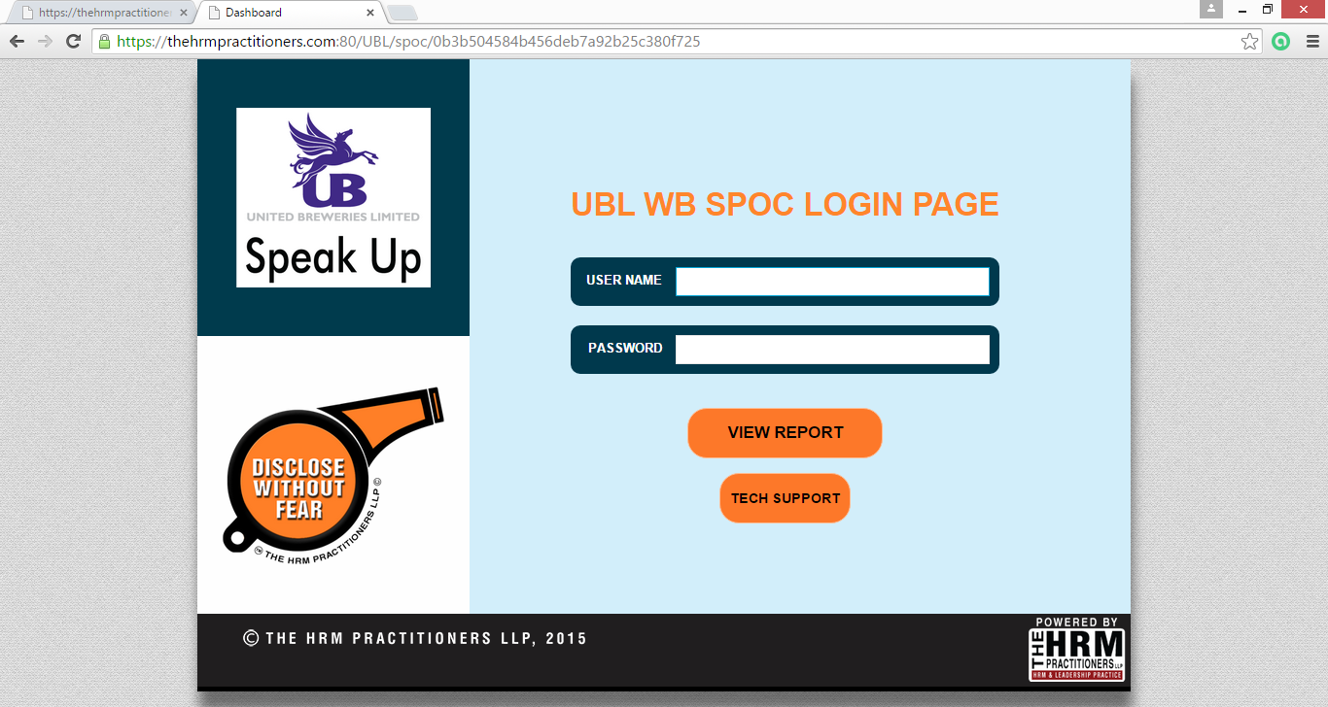
Replace with the word MANAGER
Replace

Slide 10
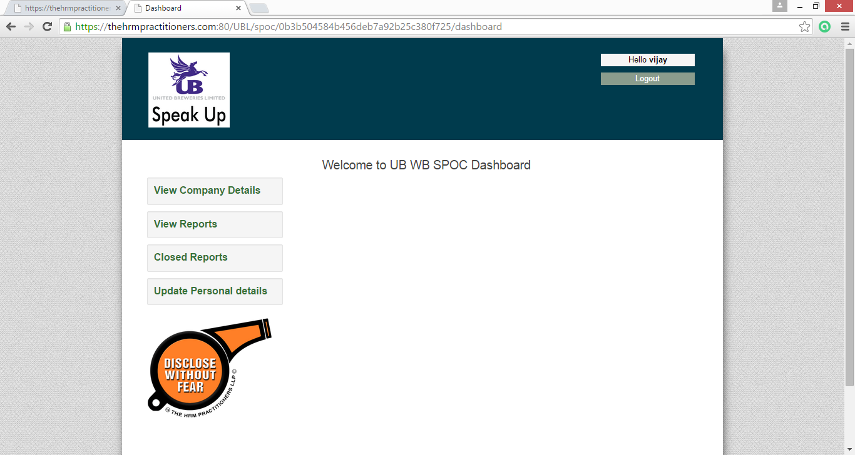

Slide 11
